Slide 1

Business Analytics Capstone Framework for Effect and Measurement
Anggi Firdian Saputra
30th August 2022

Slide 2
Effects and Measurement

Slide 3
Effects Describe the anticipated effects of your strategy
Please describe the anticipated effects of your strategy. Make sure you address the effects on customers, revenue, and the internal organization.
The following are the anticipated effects of the strategy of creating a sustainable advertisement ecosystem:
The first proposed strategy is to generate a much greater advertising experience (by tightening QA of advertising content’s deliverable. Deploying the result in which new native ads appear as a result of A/B testing) would be addressed end-users loyalty by staying on our page without taking any action to install ad-blocking software. End-users would pleasantly stay on the page because they are perceiving valuable and informative insight from the ad’s content. Subsequently, brand awareness and customer engagement can be reached.
For such circumstances we are maintaining our user base, which becomes key players to the ads impression, click, conversion
(if any of them are piqued by the product/service), and subsequently would bring beneficiary impact to profit our customer
and our revenue. Internally, as mentioned I dedicated team of creative content advertisement is needed to ensure the quality,
this might need the accrual cost and hind the financial statement, but it would make a significant impact on long-term
corporate value.
The second strategy is ambidextrous tactics by creating a solid innovative and collaborative culture in the advertising team would also make successful strategy execution and a great way to avoid member turnover challenges. As of trade-off, the considerable incentive for those who perform well is encountered, but it will make a conducive ecosystem to achieve considerable growth which improves the intangible asset and competitiveness factor of the company and become an indirect driver of long-term growth.
If we start charging the customers, we might expect a decrease in the number of users who use our services thus decreasing revenues.
From Financial Standpoint, charging the customers might increase or decrease the revenue depending on the number of users who quit.
If customer satisfaction increases, the publishers might be willing to invest more in advertising on our platforms.

Slide 4
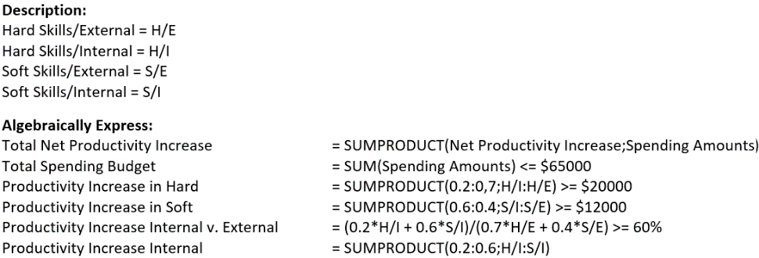
Effects Application Exercise 3 – Designing a Deterministic Optimization Model
Provide an explanation of the calculations you performed to build an optimization model using decision variables, constraints, and an objective; this model could use the scenario in Application Exercise 3, or one of you own devising.
Optimization Model on Training Program Use the Scenario in Application Exercise 3.
To get the best decision, I use a tool of solver in Microsoft Excel.
From the analytic of solver that is shown in the appendix page section, in order to maximize the productivity return which obtained $42.823 after doing the calculation of solver, the spending amount of training on Hard Skill/Internal and Soft/Skill External are 0, that means does not need to conduct any training both. The company should consider the budget expense of $26.765 for training on Soft Skill/Internal and $38.235 for training on Hard Skill/External.
However, according to me, there are several considerations such as any modeling has a limitation that could not scope the correlation between predicted and objective entirely, and training programs are related to human resources of which we know that people are the product of dynamic change and growth, thus training on Hard Skill/Internal and Soft Skill/External might also imperative for employees to do the job greatly. This is the case when blending the experts and analytics are considerably needed to achieve a much greater outcome toward the company’s objective.

Slide 5
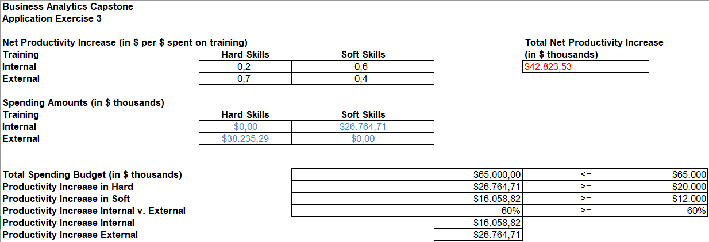
Effects - Appendix Application Exercise 3 – Designing a Deterministic Optimization Model
Provide an explanation of the calculations you performed to build an optimization model using decision variables, constraints, and an objective; this model could use the scenario in Application Exercise 3, or one of you own devising.

Slide 6
Measurement Describe the anticipated effects of your strategy and how you will measure them
Please outline your plan for measuring these effects using data. Make sure you use techniques you learned about in the courses.
The anticipated effects can be measured in the following ways:
Measurement of Ads Performance
Ads experience can be measured by the number of impressions, and video play length 25%, 50%, 76%, or 100% (quantiles)
Ads performance can be measured by:
Return of Investment (ROI) metrics (Revenue – Cost of goods sold) / Cost of goods sold
Brand awareness which can be seen from the number of impressions
Customer engagement can encounter by Click-Through Rate (CTR) and conversion rate
Customer satisfaction can be assessed from the surveys conducted.
Measurement of Internal Performance
Innovative culture: percent growth of innovation produced
Collaborative culture: percent drop of employee turnover and evaluation result of Collaborative Network
Growth in Intangible Assets.
Measurement of Company Competitive Advantage Across Industry
Return on Equity
Profitability which measures Return on Assets and Return on Sales
Efficiency encountered Assets Turnover as the key ratio
Balanced scorecard
The revenues can be measured in traditional ways.
The added factors of subscription charges can also be used in revenue measurements.

Slide 7
Measurement Application Exercise 4 – Identifying Key Drivers
Apply the “causal business model” performance measurement framework to your strategy
Causal Business Model Performance Measurement Framework
The purpose of making this causal business model is to achieve net income growth from advertisement services against ad-blocking.
Measurement:
Great experience from ads content can be seen from Brand Awareness measured by the number of impressions, Customer Engagement measured by CTR, ROI metrics, and subsequently to results of a survey conducted.
Causal Business Model as Hypothesis:
When users perceive a greater experience of ads content, this is would increase end-users loyalty where they would not install ad-blocking which would impact the number of impressions, CTR, and Conversion with driver revenue of GYF’s clients. Where more profit per impression achieves, leads to more GYF’s revenue in the long run.
Hypothesis validation:
To Conduct research and modeling through multivariate regression analysis to know whether the experience of ads contents taking the most valuable predictor to revenue increase among other key drivers, i.e. solid innovation and collaborative culture of ads team members. If it does, then the payment value of predictor experience of ads content would be the highest.
Supporting data needed:
Scanner Data. To know the growth of impressions, clicks, conversion, and turnover of ad-blockers users.
Mobile Survey from end-users population regarding ads performance measurement.
Mobile Data Analytics. To know whether a segment of our end-users is using ad-blockers, and how far it would impact our end-users data analytics.
Social Media. To capture our ads engagement and ads personal.
Number of innovations produced and perform
Evaluation results of the collaboration network
Financial measurement metrics.
Pricing Analysis. To decide which option would be suitable: charging the customers or paying the adblocking companies to get whitelisted.
Optional other key drivers for revenue increase or decrease:
Decrease in Obtrusive ads: This will increase customer satisfaction which will lead to not using adblockers which will help to retain more publishers which will lead to the prevention of losses.
Charging the customers: This will lead to a decrease in the number of users but might lead to an increase or decrease in the revenue depending on customer turnover.
Paying the adblocking companies: This might lead to short-term revenue but might help in the long term by retaining publishers and decreasing losses.

Slide 8
Measurement Application Exercise 4 – Identifying Key Drivers
Apply the “causal business model” performance measurement framework to your strategy
Linking non-financial metrics to financial objective
There is also a probability when the key driver mentioned would not perform. If this happened, we should find out why. There are three possible reasons that are the strategy aligned wrong, the measurement is garbage where we can eliminate this possibility since we use common measurement in the industry for a decade, and the people who are doing the job are not dependable.
This is when financial metrics take a considerable role in financial objectives. We should evaluate and do the right measurement on non-financial metrics (in this case the innovative and collaborative culture, management capability, employee relation, quality, and brand value) to know the causal reason of the issues. If the case is solved, which we see the highest predictable factor of key drivers makes increasing net income successfully, this means both non-financial metrics and financial outcomes are highly correlated as it supposed to be. That is why most of the corporations nowadays use a Balanced Score Card to measure how well one company is doing, especially their competitive advantage across the industry.

